Slide 1
Introduction to Spring Boot

Slide 2
Contents
Overview of Spring Boot
Creating a simple Spring Boot app
Creating a Spring Boot web app
Exercise
Demo folder
DemoIntroSpringBoot

Slide 3
1. Overview of Spring Boot
What is Spring Boot?
Getting Spring Boot
Spring Boot documentation
What can you do with Spring Boot?
Sping Boot features

Slide 4
What is Spring Boot?
Spring Boot is a framework from Pivotal, to simplify developing and running Spring applications
Dramatically minimizes the amount of boilerplate configuration
Makes extensive use of "convention over configuration"
We say Spring Boot is "opinionated"
Allows you to create completely standalone applications
Applications can contain built-in servers, e.g. Tomcat or Jetty
No need for an external web server host to run on
You can just run a Spring Boot application as a regular Java app
java –jar MySpringBootApp.jar

Slide 5
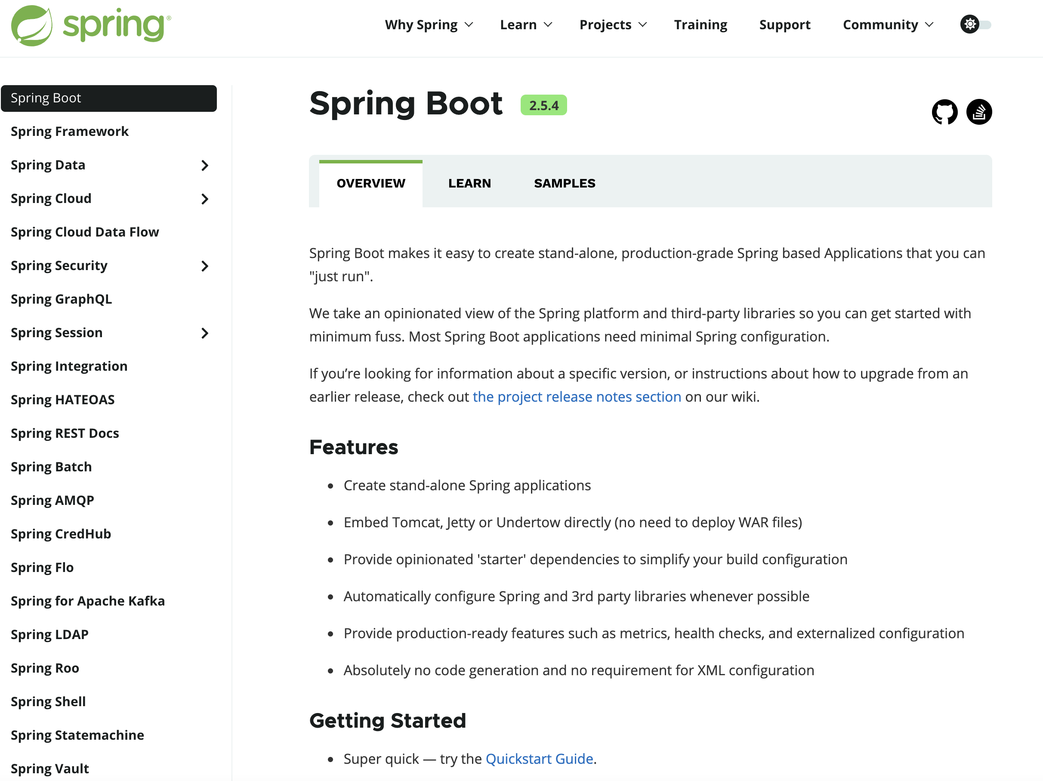
Getting Spring Boot
You can get the Spring Boot project here:
https://spring.io/projects/spring-boot

Slide 6
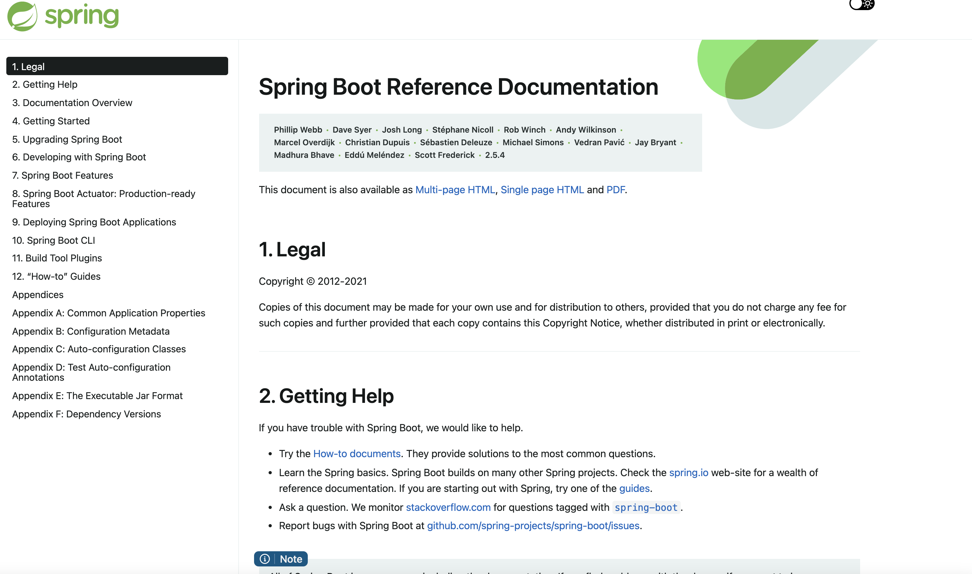
Spring Boot Documentation
Extensive Spring Boot documentation is available here:
https://docs.spring.io/spring-boot/docs/current/reference/htmlsingle

Slide 7
What Can You Do With Spring Boot?
Spring Boot has extensive APIs that address all aspects of contemporary systems
Web applications
REST services
SQL and NoSQL data sources
Distributed transactions
Messaging
JMX monitoring
Spring Integration
Spring Cloud and Data Flow
Web Sockets
SOAP services
Plus testing, security, logging, etc.

Slide 8
Spring Boot Features (1 of 2)
Spring Boot Application Starters
Convenient dependency descriptors you can include in your app
Contain a lot of the dependencies you need to get a project started
E.g. spring-boot-starter
E.g. spring-boot-starter-web
E.g. spring-boot-starter-data-jpa
Spring Boot Auto Configuration
Detects the presence of certain frameworks (e.g. Spring Data JPA)
Auto-configures that framework with sensible defaults
You can override the defaults via your own configuration
Dramatically reduces the amount of config you have to write

Slide 9
Spring Boot Features (2 of 2)
Standalone & Opinionated
Package application → Run as standalone – java –jar app.jar
Production ready application with embedded webservers
Takes opinionated view and configures application with standard libraries example - web, logging, collection framework, and the build tools
Spring Boot Actuator
A module you can include in your Spring Boot application, to add support for metrics, health monitoring, etc.
Spring Boot Developer Tools
A module you can include in your Spring Boot application, to add support for development tools (e.g. restart app if files change)

Slide 10
2. Creating a Simple Spring Boot App
Overview of Spring Boot CLI
Using Spring Boot CLI
Creating a simple Spring Boot app
Application structure
Maven POM file
Code artifacts
Running the application

Slide 11
Overview of Spring Boot CLI
Spring Boot CLI is a command-line tool for creating and running Spring Boot applications
Generates a template application in Java or Groovy
In Java, you can specify whether to use Maven or Gradle
Reference - https://docs.spring.io/spring-boot/docs/current/reference/html/cli.html
You can download the Spring CLI distribution from the Spring Boot repository, via one of the following URLs:
https://repo.spring.io/release/org/springframework/boot/spring-boot-cli/2.5.4/spring-boot-cli-2.5.4-bin.zip
https://repo.spring.io/release/org/springframework/boot/spring-boot-cli/2.5.4/spring-boot-cli-2.5.4-bin.tar.gz

Slide 12
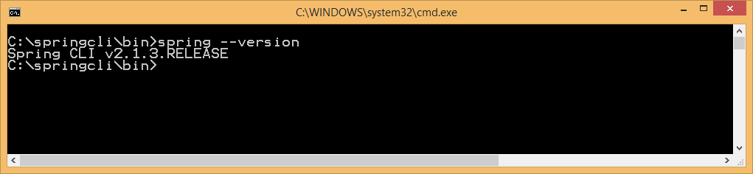
Using Spring Boot CLI
We've already downloaded Spring CLI
We've installed it in C:\springcli
We've added C:\springcli\bin to the PATH
To run Spring CLI:
Open a Command Prompt window
Run spring.bat and verify the version
spring --version

Slide 13
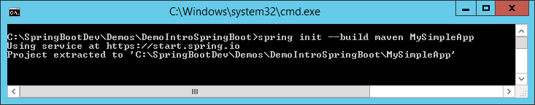

Creating a Simple Spring Boot App
To create a simple Spring Boot Maven-based app:
The init command tells Spring CLI to create a new app
Spring CLI calls a web service at https://start.spring.io
This creates a simple Spring Boot app (zipped)
Spring CLI extracts the zip into the specified folder
To check cli options
spring init --build maven MySimpleApp

Slide 14
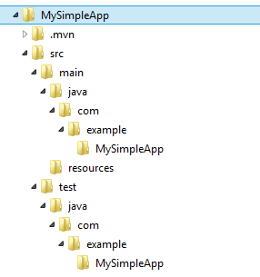
Application Structure
The generated application is a regular Maven project

Slide 15
Maven POM File
Here are the relevant sections in the Maven POM file
<project … >
…
<packaging>jar</packaging>
<parent>
<groupId>org.springframework.boot</groupId>
<artifactId>spring-boot-starter-parent</artifactId>
<version>2.1.3.RELEASE</version>
<relativePath/>
</parent>
<dependencies>
<dependency>
<groupId>org.springframework.boot</groupId>
<artifactId>spring-boot-starter</artifactId>
</dependency>
<dependency>
<groupId>org.springframework.boot</groupId>
<artifactId>spring-boot-starter-test</artifactId>
<scope>test</scope>
</dependency>
</dependencies>
…
</project>
Package app as a JAR
Parent POM
Spring Boot dependency
Spring Boot test dependency

Slide 16
Code Artifacts
Here's the generated application code
@SpringBootApplication is a convenience annotation equivalent to declaring 3 separate annotations:
@SpringBootConfiguration → @Configuration
@EnableAutoConfiguration
@ComponentScan
package com.example.MySimpleApp;
import org.springframework.boot.SpringApplication;
import org.springframework.boot.autoconfigure.SpringBootApplication;
@SpringBootApplication
public class DemoApplication {
public static void main(String[] args) {
SpringApplication.run(DemoApplication.class, args);
}
}
DemoApplication.java

Slide 17
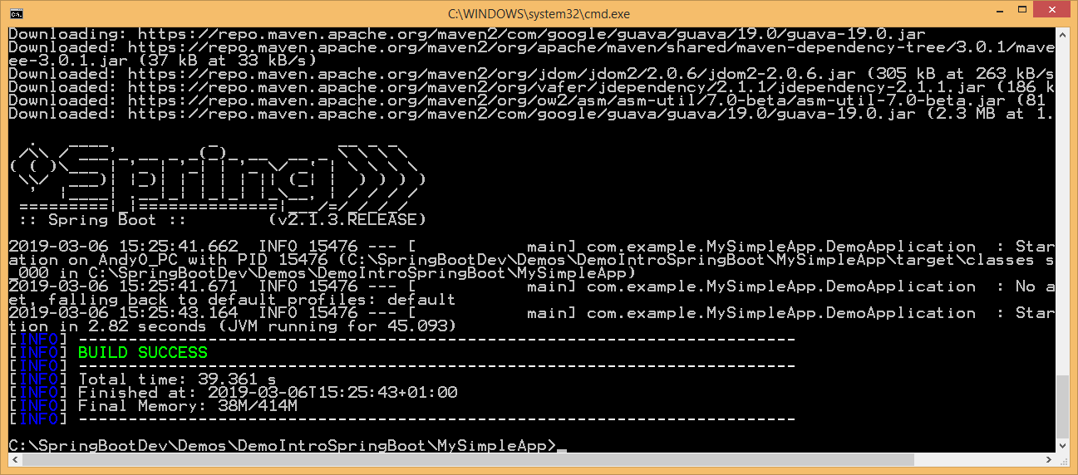
Running the Application
You can build/run the application via Maven as follows
mvn spring-boot:run

Slide 18
3. Creating a Spring Boot Web App
Overview
Creating a web app using Spring Boot CLI
Web application structure
Maven POM file
Adding web content
Configuring the web server port
Running the application
Pinging the web server

Slide 19
Overview
Spring Boot makes it very easy to develop web apps
Include spring-boot-starter-web in your POM
Implement web artifacts, e.g. HTML pages, JSPs, etc.
You typically package the app as a JAR (not a WAR)
Contains a built-in Tomcat or Jetty web server
You can then run it as a standalone Java app

Slide 20
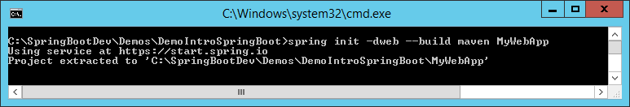
Creating a Web App using Spring Boot CLI
You can use Spring Boot CLI to create a web app
Note the -d option
Specifies dependencies
We've just specified the web dependency here
Many dependencies are available, e.g. jdbc, data-jpa, etc.
spring init -dweb --build maven MyWebApp

Slide 21
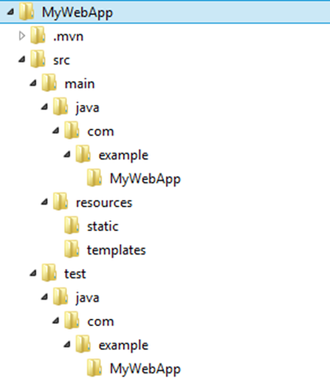
Web Application Structure
The generated application is a regular Maven web project
Put your static HTML content here

Slide 22
Maven POM File
The POM file now specifies the Spring Boot web starter
<project … >
…
<packaging>jar</packaging>
<parent>
<groupId>org.springframework.boot</groupId>
<artifactId>spring-boot-starter-parent</artifactId>
<version>2.1.3.RELEASE</version>
<relativePath/>
</parent>
<dependencies>
<dependency>
<groupId>org.springframework.boot</groupId>
<artifactId>spring-boot-starter-web</artifactId>
</dependency>
<dependency>
<groupId>org.springframework.boot</groupId>
<artifactId>spring-boot-starter-test</artifactId>
<scope>test</scope>
</dependency>
</dependencies>
…
</project>
Spring Boot web dependency

Slide 23
Adding Web Content
The code artifacts are exactly the same as the simple app we saw earlier
Specifically, there's no need for a WEB-INFO folder, web.xml, etc.
We can just add static content directly
In the src\main\resources\static folder
E.g. let's add a simple HTML file
<html>
<head>
<title>Home</title>
</head>
<body>
Hello world!
</body>
</html>
index.html

Slide 24
Configuring the Web Server Port
Spring Boot is "opinionated"
It has lots of default settings, which makes life easy for you
You can override the default setting if you want/need to
E.g. by default Web server in a Spring Boot application starts on port 8080
You can specify a different port number (e.g. to avoid port conflict)
Edit src\main\resources\application.properties
Set the server.port property
server.port=8081
application.properties

Slide 25
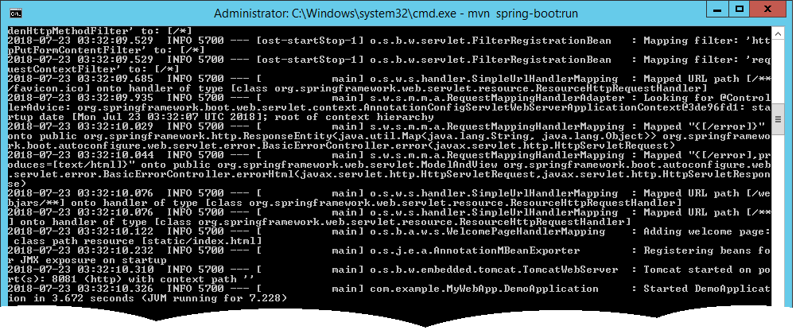
Running the Application
Build/run the application via Maven as before
mvn spring-boot:run
App contains an embedded Tomcat server
When the app starts, Tomcat starts up on the specified port (default is 8080)

Slide 26
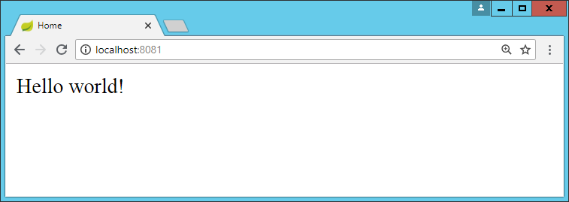
Pinging the Web Server
Open a browser and navigate to http://localhost:8081
Renders index.html, because this is a default filename

Slide 27
Any Questions?

Slide 28

Exercise (1 of 2)
Use Spring CLI to create a Spring Boot web application
Add some static content to the web app
E.g. HTML files, CSS style sheets, etc.
Build and run the web app
View the web app in a browser
Verify it works as expected
See sample solution on next slide

Slide 29
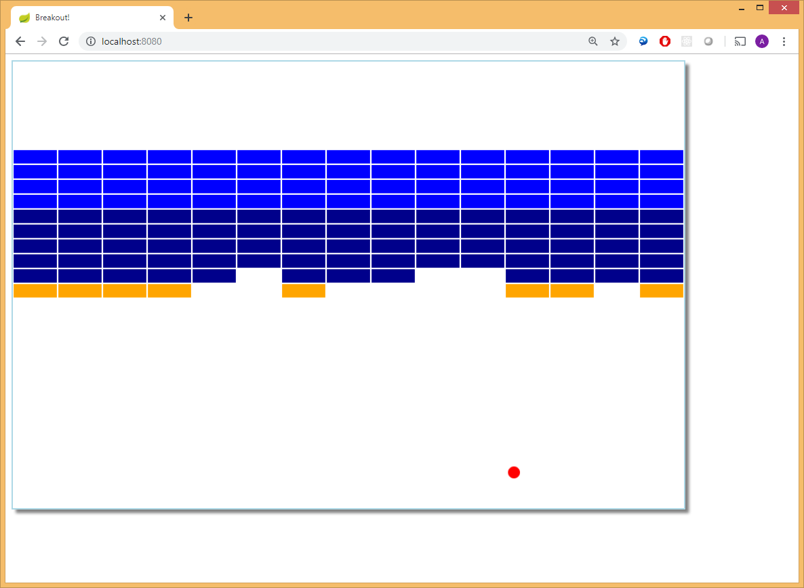
Exercise (2 of 2)
Here's our sample solution
See Solutions\SolutionIntroSpringBoot folder
It's the "Breakout" game ☺

